Slide 1


IT343: Operating System
July – November 2020
Chapter – 3&4
Process Management And Scheduling
Devang Patel Institute of Advance Technology and Research

Slide 2
Topic to cover
2. | Process Management
2.1 | Process, Process Control Block, Process States,
2.2 | Threads, Types of Threads and Dispatching, Concurrent Threads

Slide 3
Outline
Process Concept
Process States
Process Control Block
Process Scheduling
Schedulers
Context switching
Scheduling Criteria
‹#›

Slide 4
process
A process is sequential program in execution.
A process defines the fundamental unit of computation for the computer.
Components of process are :
Object Program: code to be executed
Data: Used for executing the program.
Resources: While Executing program it may require resources
Status of the process execution: Used for verifying the status of the process execution
‹#›

Slide 5
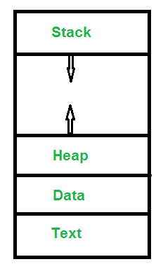
What does a process look like in Memory?
‹#›

Slide 6
Program to Process
We write a program in e.g., Java.
A compiler turns that program into an instruction list.
The CPU interprets the instruction list (which is more a graph of basic blocks).
void X (int b) {
if(b == 1) {
…
int main() {
int a = 2;
X(a);
}

Slide 7
Process in Memory
What is in memory.
Program to process.
main; a = 2
What you wrote
Stack
X; b = 2
void X (int b) {
if(b == 1) {
…
int main() {
int a = 2;
X(a);
}
Heap
void X (int b) {
if(b == 1) {
…
int main() {
int a = 2;
X(a);
}
What must the OS track for a process?
Code

Slide 8
Program v/s process
Program | Process
Set of instruction/code. | When program is going for execution is called process.
Passive entity. | Active entity.
Reside in secondary memory. | Reside in main memory.
A program exists at single place in space and continues to exist. | Process exists in a limited span of time.
Consumes no resources. | Consumes required resources.
A program does not perform the action by itself. | Two or more processes could be executing the same program, each using their own data and resources.
‹#›

Slide 9
Process relationship
One to One
A single execution of a sequential program
Many to One
Many simultaneous executions of program
Execution of a concurrent program
‹#›

Slide 10
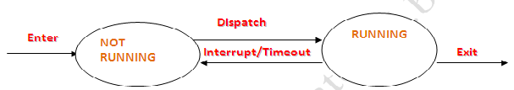
Process State
When process executes, it changes state.
Process state is defined as the current activity of the process.
TWO STATE PROCESS MODEL :-
when O.S. is create the process and enter into the main memory for execution this time its state will be NOT RUNNING and these processes are waiting for the execution.
When process is going for execution its state is called RUNNING.

Slide 11
5 state of Process
1. New
2. Ready
3. Running
4. Waiting
5. Terminated
‹#›

Slide 12
Process States
As a process executes, it changes state
New:
A process that has just created by the O.S., but not submit into the Queue for execution.
Ready:
The process is waiting to be assigned to a processor
When process in main memory and ready for the execution but execution is not start. This state of process is called Ready State.
During the execution if any interrupt generate by system or process is timeout than it will send back to Ready state.

Slide 13
Process State:
Running:
When process is currently executing by processor then its state is called Running state.
Dispatcher will provide process to processor for execution.
At a time only one process can be executed
Block/Waiting:
The process is waiting for some event to occur
when Process is executing and during execution if any event or I/O operation is in waiting for completion of process than process cannot execute until event occurs.
This process will declare as Block Process. This state is called Block/Waiting state.
When Event will occur than process will come into Ready state.
Terminated:
The process has finished execution
process will release by processor

Slide 14
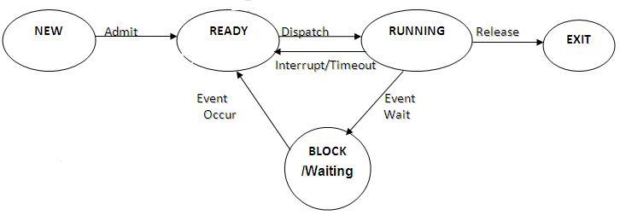
5 State process state model
It depicts the different states and the transitions between states that a process makes during execution.

Slide 15
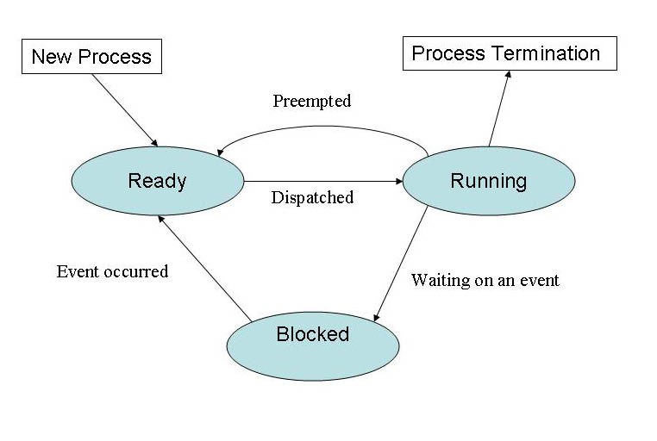
CPU preemption process state diagram
‹#›

Slide 16
CPU Preemption Reason
Higher priority process initiate
Time quantum expire
‹#›

Slide 17
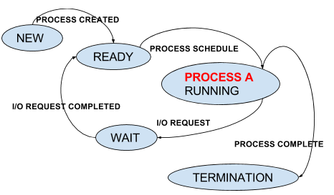
CPU Non-preemption process state diagram
‹#›

Slide 18
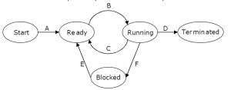
Q-01
I. If a process makes a transition D, it would result in
another process making transition A immediately.
II. A process P2 in blocked state can make transition E
while another process P1 is in running state.
III. The OS uses preemptive scheduling.
IV. The OS uses non-preemptive scheduling.
Which of the above statements are TRUE?
‹#›

Slide 19
Solution
If a process makes a transition DD, it would result in another process making transition A immediately. - This is false. It is not said anywhere that one process terminates, another process immediately come into Ready state. It depends on availability of process to run & Long term Scheduler.
A process P2 in blocked state can make transition E while another process P2 is in running state. - This is correct. There is no dependency between running process & Process getting out of blocked state.
The OS uses preemptive scheduling. :- This is true because we got transition CC from Running to Ready.
The OS uses non-preemptive scheduling. Well as previous statement is true, this becomes false.
So answer is II and III .
‹#›

Slide 20
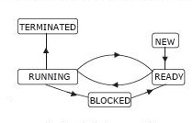
Q-02 The process state transition diagram in the below figure is representative of
a batch operating system
an operating system with a preemptive scheduler
an operating system with a non-preemptive scheduler
a uni-programmed operating system
‹#›

Slide 21
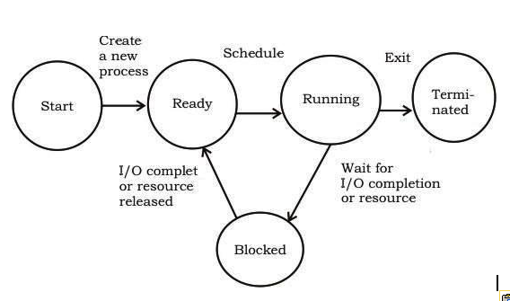
Q-3 The process state transition diagram of an operating system is as given below.
It is a multiprogrammed operating system
It uses preemptive scheduling
It uses non-preemptive scheduling
It is a multi-user operating system
Which of the following must be FALSE about the above operating system?
‹#›

Slide 22
7 State process state model
Ready Suspended
when Ready queue will be full, some process will be suspended temporarily , and store into the Ready suspended Queue.
And its state is called ready suspended.
When Ready queue will be free to store process than process from Ready suspend queue will store back into the Ready Queue.
Block suspended
when block queue will be full, some process will be suspended temporarily, and store into the block suspended Queue.
Its state is called block suspended.
When block queue will be free to store process than process from block suspend queue store back into the block Queue.
‹#›

Slide 23
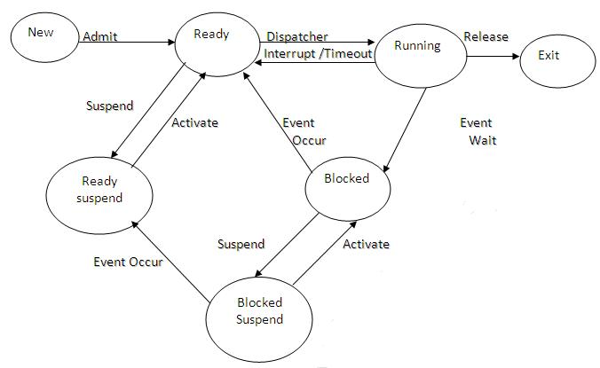
7 State process state model
‹#›

Slide 24
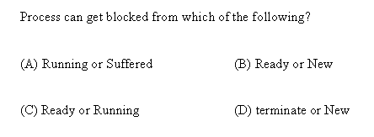
Q-02
Answer-C
‹#›

Slide 25
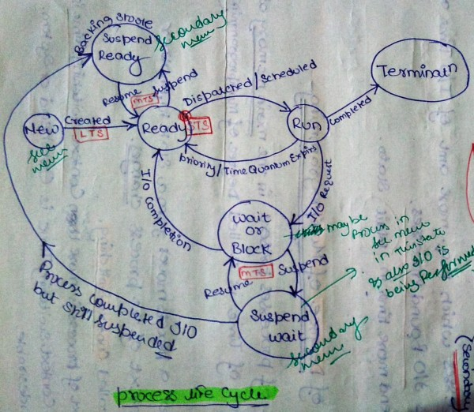
‹#›

Slide 26
Answer-C
here is a state called suspend ready, when system needs to free up resources, some processes are moved to that state from ready state
‹#›

Slide 27
Special Cases
Blocked Suspend -----🡪 Block/Waiting
Running----------------🡪 Ready Suspend
Ready-----------------🡪 Ready Suspend
‹#›

Slide 28
Process Control Block (PCB)
Operating system provide the management of all the processes of system like
process creation, process termination, process execution and process scheduling etc.
OS maintain the table to store information about process is called process control block (PCB).
It is also called data structure of process.(kernel data structure)
TCB(Task Control Block) or Process Descriptor or Process Object

Slide 29
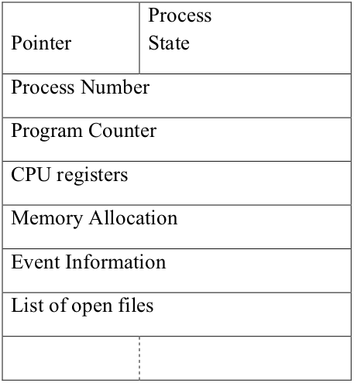
Process Control Block (PCB)

Slide 30
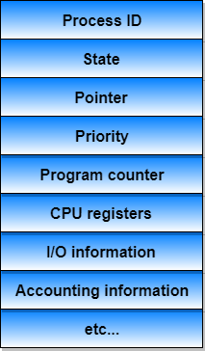
PCB
‹#›

Slide 31
Process Control Block (PCB)
Information associated with each process
Pointer
Pointer points to another process control block. Pointer is used for maintaining the scheduling list. (Info. Of processes are maintained as a link list)
Process state
Process state may be new, ready, running, waiting and so on.
Program counter
It indicates the address of the next instruction to be executed for this process.

Slide 32
Process Control Block (PCB)
CPU registers
It indicates general purpose register, stack pointers, index registers and accumulators etc.
Number of register and type of register totally depends upon the computer architecture.
On an interrupt this state information along with program counter is saved to allow a process to continue correctly later.
Memory Management Information :
This information may include the value of base and limit register, page table/segment table.
This information is useful for deallocating the memory when the process terminates.
‹#›

Slide 33
Process Control Block (PCB)
Accounting Information :
This information includes the amount of CPU and real time used, time limits, job or process numbers, account numbers etc.
Process control block also includes
The information about CPU scheduling,
I/O resource management,
File management information,
Priority and so on.
‹#›

Slide 34
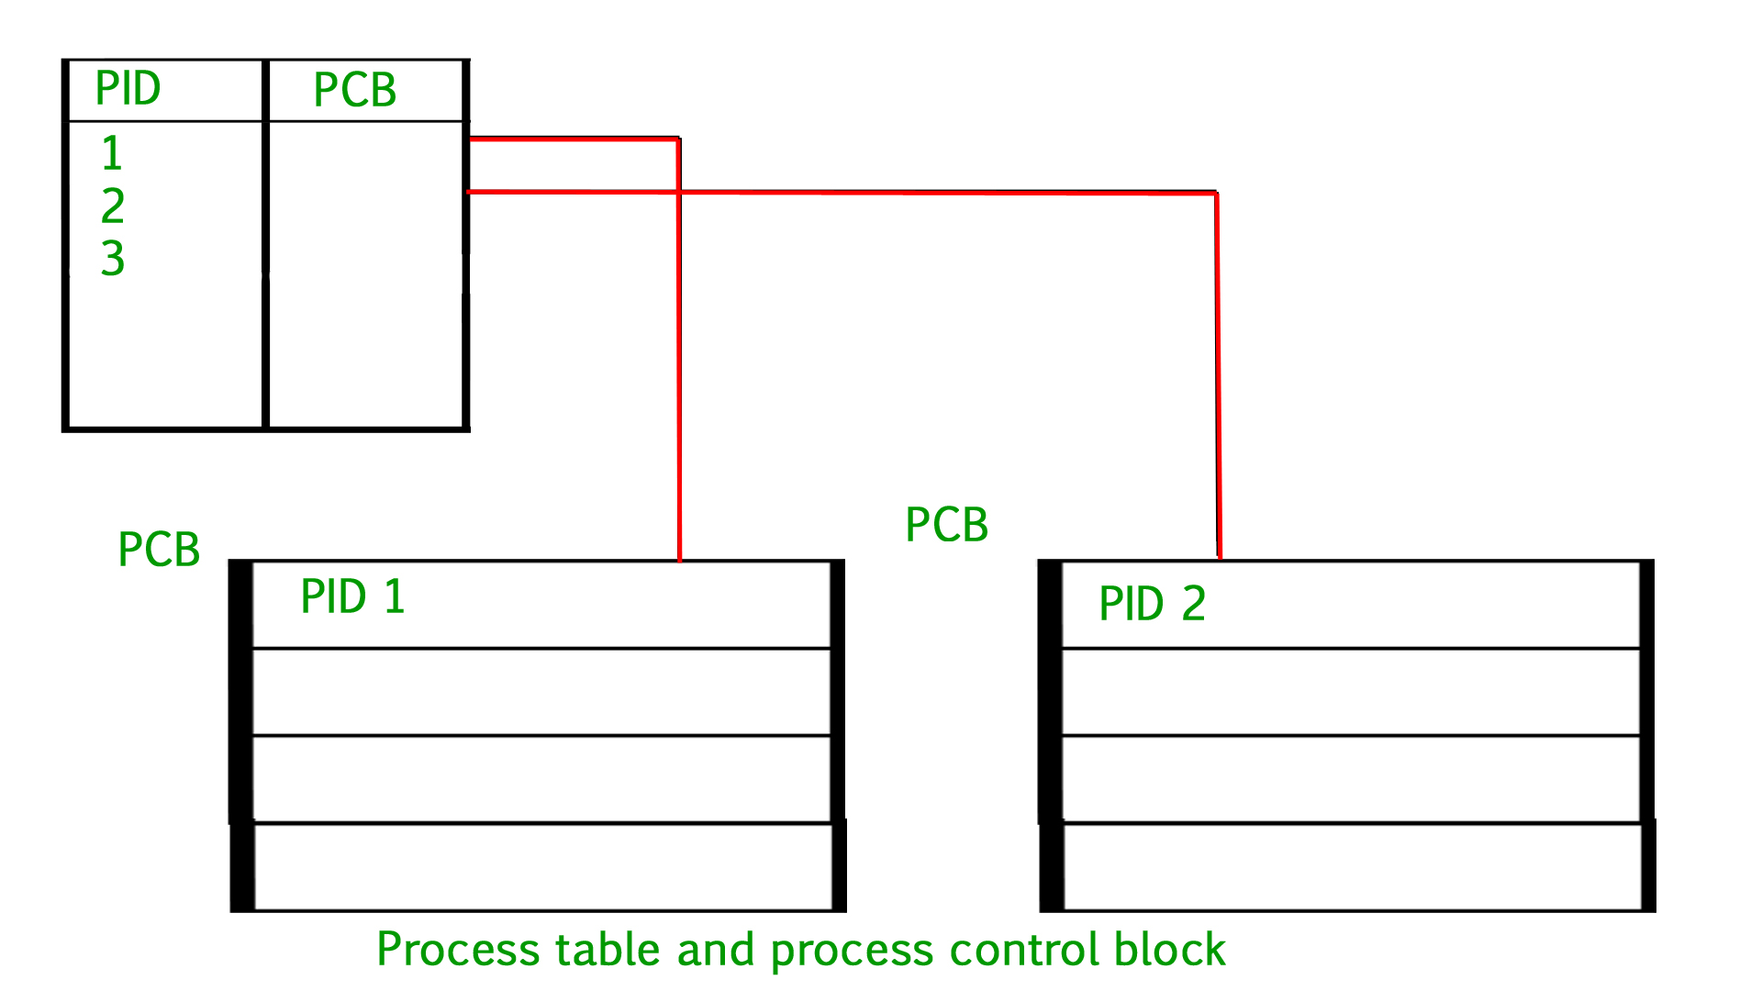
PCB
‹#›

Slide 35
Process Scheduling
In multiprogramming, more than one process and only one processor
therefore only one process can go for execution at a time And rest of the process has to wait for execution.
OS is responsible for the scheduling of processes. And controlling the execution of process.
Maximize CPU use, quickly switch processes onto CPU for time sharing
Process scheduler selects among available processes for next execution on CPU

Slide 36
Process Scheduling
Maintains scheduling queues of processes
Job queue – set of all processes in the system
Ready queue – set of all processes residing in main memory, ready and waiting to execute
Device queues – set of processes waiting for an I/O device
Each device has its own queue.
Processes migrate among the various queues
‹#›

Slide 37
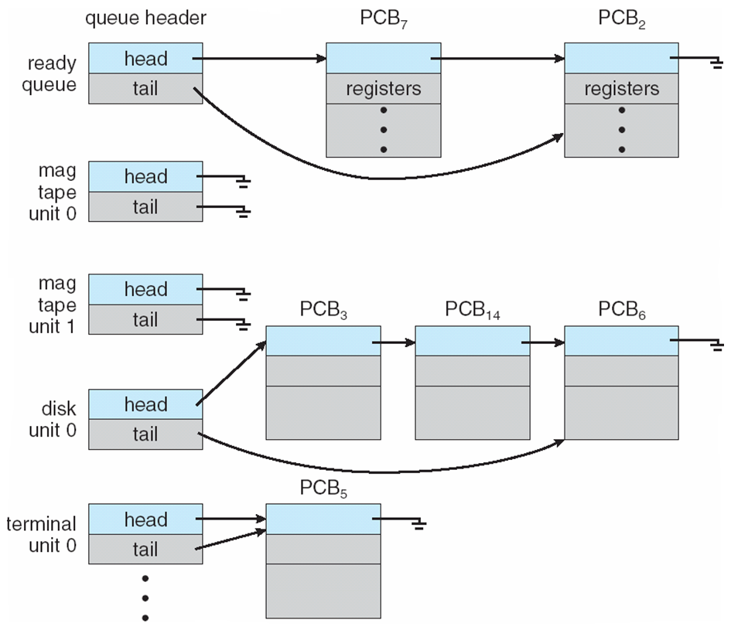
Ready Queue And Various I/O Device Queues

Slide 38
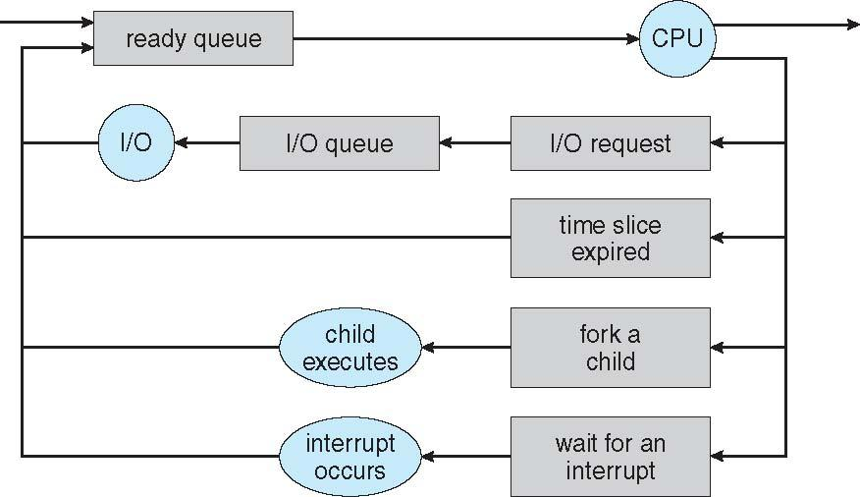
Representation of Process Scheduling
Queuing Diagram

Slide 39
Process scheduling using queuing diagram
A new process is put in the ready queue initially.
It waits in ready queue till selected for execution.
While executing the process, one of the several events could occur.
The process could issue an I/O request and then place in an I/O queue.
The process could create new sub process and waits for its termination.
The process could be removed forcibly from the CPU, as a result of interrupt and put back in the ready queue.

Slide 40
Context Switch
When CPU switches to another process, the system must save the state of the old process and load the saved state for the new process via a context switch.
Context of a process represented in the PCB
Context-switch time is overhead; the system does no useful work while switching
The more complex the OS and the PCB 🡪 longer the context switch
Time dependent on hardware support
Some hardware provides multiple sets of registers per CPU 🡪 multiple contexts loaded at once

Slide 41
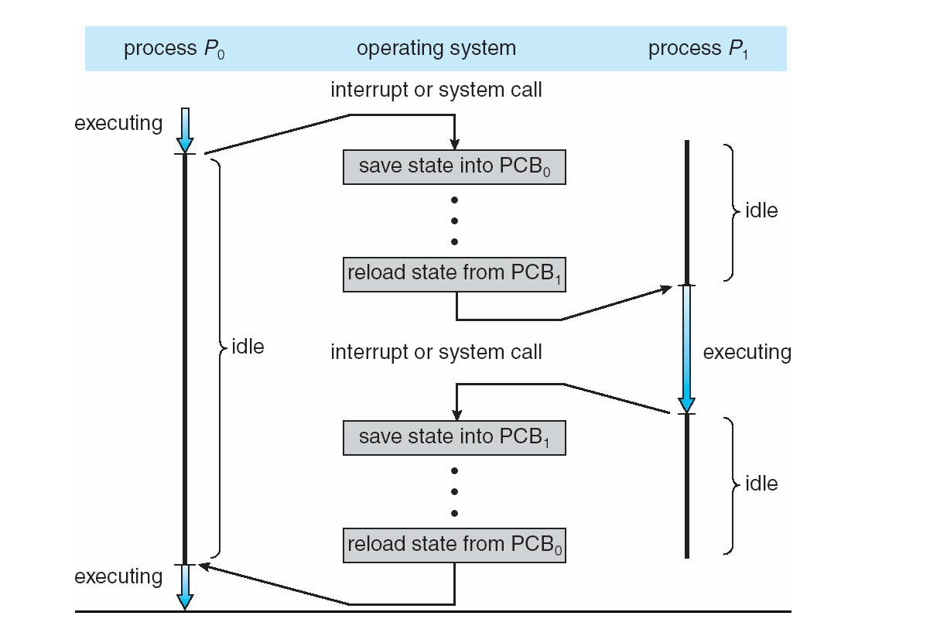
CPU Switch From Process to Process

Slide 42
Schedulers
Responsible for selecting a process for scheduling/operating with the resources
Three types of Schedulers :
Long-term scheduler (or job scheduler) – selects which processes should be brought into the ready queue
Short-term scheduler (or CPU scheduler) – selects which process should be executed next and allocates CPU
Sometimes the only scheduler in a system
Medium-term scheduler
Intermediate level of scheduling

Slide 43
Long-term scheduler (or Job scheduler)
It selects processes from the disk and loads them into memory for execution.
LTS control the degree of multiprogramming (no. of processes in memory)
It invoked only when a process leaves the system
So as to keep the degree of multiprogramming is stable,
Average rate of process creation = Average departure rate of process leaving the system.
So Execution frequency is less in comparison of others
‹#›

Slide 44
Long-term scheduler
In time sharing system LTS is not used
because in this type of system, process directly put into the ready queue.
LTS needs to select good mix of CPU bound and I/O bound processes so as to avoid the ready queue being empty with no work for STS or I/O queue to be empty and devices not being utilized.
CPU Bound process
It generates minimal or very few I/O requests and does more computation.
I/O Bound process
It does more of I/O than computation.
‹#›

Slide 45
short-term scheduler
Short term scheduler select the process from the ready queue, which are ready for the execution, and allocate the processor for execution.
STS is faster then LTS.
STS is also called CPU scheduler or dispatcher.
It is invoked each time the CPU requires a new process for execution.
‹#›

Slide 46
Medium-term schedulers
Medium term scheduler provides the swapping.
Ready Q and Block Q are loaded into the main memory. So some time to reduce the degree of multiprogramming. Process are suspended from the queue, and move to the secondary memory for temporary time, this is called swap out.
when again these processes are loaded into main memory from secondary memory for execution is called swap in.
These swap in and swap out is determine by the MTS.
Used to decrease the load of the CPU.
Used to increase process Response time.
Swapping may be necessary to improve the process mix.

Slide 47
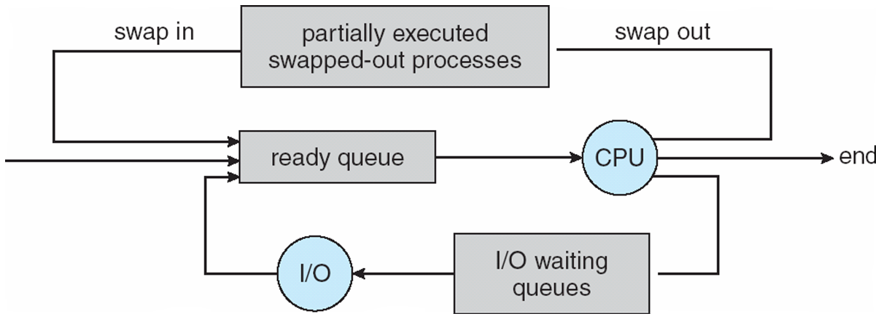
Medium Term Scheduler

Slide 48
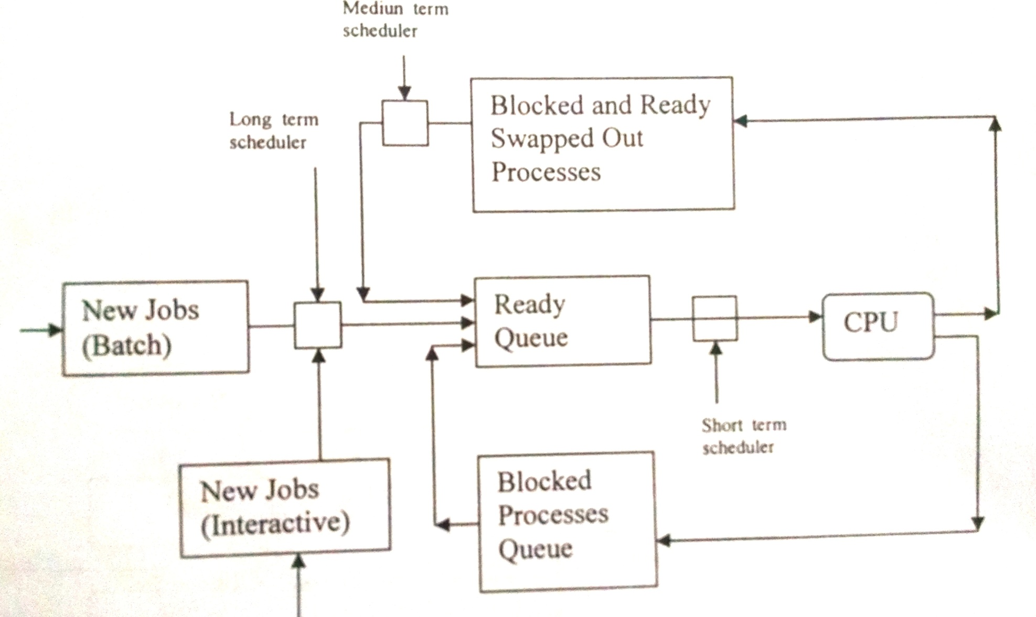
Schedulers
‹#›

Slide 49
Dispatcher
It is a component of CPU scheduling function
It gives control of the CPU to the process selected by STS.
Its functions include:
Switching the context
Switching to User mode
Jumping to the proper location in the user program to restart the selected program.
It is invoked during every process switch.
The time taken by the dispatcher to stop one process and start another process running is called dispatch latency

Slide 50
Scheduling Criteria
CPU utilization – keep the CPU as busy as possible
Throughput – # of processes that complete their execution per time unit
Turnaround time – amount of time to execute a particular process
Waiting time – amount of time a process has been waiting in the ready queue
Response time – amount of time it takes from when a request was submitted until the first response is produced, not output (for time-sharing environment)
Notes:
‹#›

Slide 51
Scheduling Algorithm Optimization Criteria
Max CPU utilization
Max throughput
Min turnaround time
Min waiting time
Min response time
Notes:
‹#›

Slide 52
Scheduling Algorithms
We'll discuss few major scheduling algorithms here which are following :
1. First Come First Serve(FCFS) Scheduling
2. Shortest-Job-First(SJF) Scheduling
3. Shortest Remaining Time First(SRTF)
4. Priority Scheduling (Non Preemptive)
5. Round Robin(RR) Scheduling
6. Multilevel Queue Scheduling
7. Multilevel Feedback Queue Scheduling
‹#›

Slide 53
different time with respect to a process
Arrival Time: Time at which the process arrives in the ready queue.
Completion Time: Time at which process completes its execution.
Burst Time: Time required by a process for CPU execution.
Turn Around Time: Time Difference between completion time and arrival time.
Turn Around Time = Completion Time - Arrival Time
Waiting Time(W.T): Time Difference between turn around time and burst time.
Waiting Time = Turn Around Time - Burst Time
‹#›

Slide 54
First-Come, First-Served (FCFS) Scheduling
Process Burst Time/CPU Time
P₁ 24
P₂ 3
P₃ 3
Suppose that the processes arrive in the order: P₁ , P₂ , P₃ The Gantt Chart for the schedule is:
Waiting time for P₁ = 0; P₂ = 24; P₃ = 27
Average waiting time: (0 + 24 + 27)/3 = 17
P₁
P₂
P₃
0
24
27
30
Notes:
‹#›

Slide 55
FCFS Scheduling (Cont.)
Suppose that the processes arrive in the order:
P₂ , P₃ , P₁
The Gantt chart for the schedule is:
Waiting time for P₁ = 6; P₂ = 0; P₃ = 3
Average waiting time: (6 + 0 + 3)/3 = 3
Much better than previous case
Convoy effect - short process behind long process
Consider one CPU-bound and many I/O-bound processes
P₂
P₃
P₁
0
3
6
30
Notes:
‹#›

Slide 56
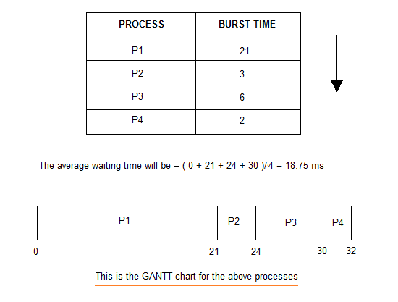
Example-01 What is the average waiting time for the four processes? (FCFS)
‹#›

Slide 57
Solution
‹#›

Slide 58
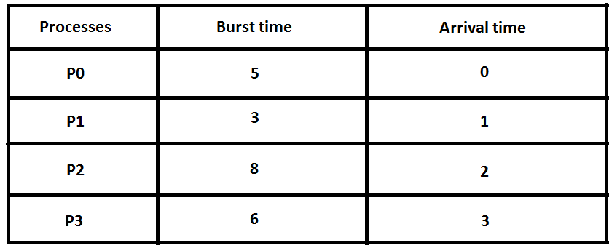
Example-02 What is the average waiting time for the four processes? (FCFS)
‹#›

Slide 59
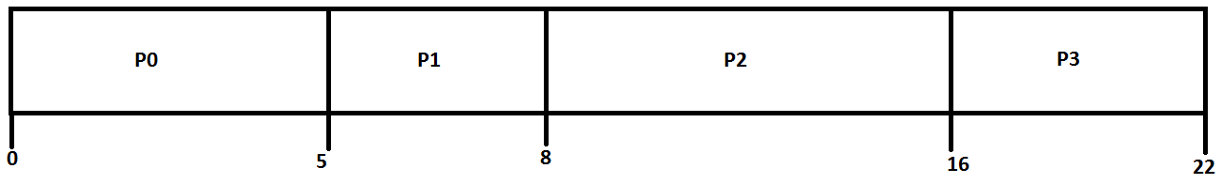
Solution
P0 ----🡪 0 - 0 = 0
P1----🡪 5 - 1 = 4
P2 ---🡪 8 - 2 = 6
P3 ---🡪 16 - 3 = 13
Average Wait Time: (0 + 4 + 6 + 13) / 4 = 5.75
‹#›

Slide 60
Example-03 What is the average turn around time for the four processes? (FCFS)
Process | Arrival time | CPU time
P1 | 0 | 8
P2 | 2 | 2
P3 | 6 | 1
P4 | 8 | 6
P5 | 12 | 4
Avg. turn around time = (8+8+5+9+9)/5 = 7.8
‹#›

Slide 61
Shortest-Job-First (SJF) Scheduling
Associate with each process the length of its next CPU burst
Use these lengths to schedule the process with the shortest time
SJF is optimal – gives minimum average waiting time for a given set of processes
The difficulty is knowing the length of the next CPU request
Could ask the user
Notes:
‹#›

Slide 62
Example of SJF (arrival time = 0) Find AVG Waiting Time=?
ProcessA riva l Burst Time
P₁ 0.0 6
P₂ 2.0 8
P₃ 4.0 7
P₄ 5.0 3
SJF scheduling chart
Average waiting time = (3 + 16 + 9 + 0) / 4 = 7
P₄
P₁
P₃
P₂
0
3
9
16
24
Notes:
‹#›

Slide 63
Example-01 What is the average waiting time for the four processes? (SJF)
‹#›

Slide 64
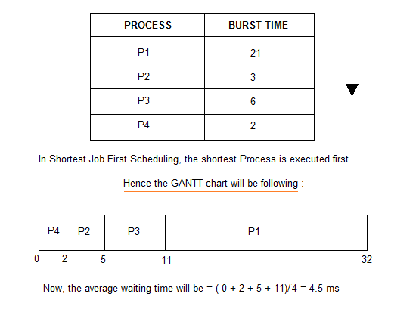
Example-1
‹#›

Slide 65
Example of Shortest-remaining-time-first
Now we add the concepts of varying arrival times and preemption to the analysis
ProcessA arri Arrival TimeT Burst Time
P₁ 0 8
P₂ 1 4
P₃ 2 9
P₄ 3 5
Preemptive SJF Gantt Chart
Average waiting time = [(10-1)+(1-1)+(17-2)+5-3)]/4 = 26/4 = 6.5 msec
P₁
P₂
P₄
P₁
P₃
0
1
5
10
17
26
Notes:
‹#›

Slide 66
Example-1 SRTF
------------------------------------- Process Arrival-Time Burst-Time ------------------------------------- P1 0 5 P2 1 3 P3 2 3 P4 4 1 ------------------------------------- What is the average turnaround time for these processes with the preemptive shortest remaining processing time first (SRTF) algorithm? (a) 5.50 (b) 5.75 (c) 6.00 (d) 6.25
‹#›

Slide 67
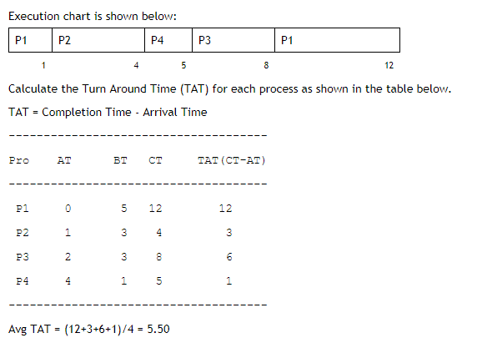
solution
‹#›

Slide 68
Example-02
An operating system uses Shortest Remaining Time first (SRTF) process scheduling algorithm. Consider the arrival times and execution times for the following processes:
-------------------------------------
Process Execution time Arrival time
-------------------------------------
P1 20 0
P2 25 15
P3 10 30
P4 15 45
-------------------------------------
What is the total waiting time for process P2?
(a) 5 (b) 15 (c) 40 (d) 55
‹#›
What is the average Turnaround Time & Waiting Time?

Slide 69
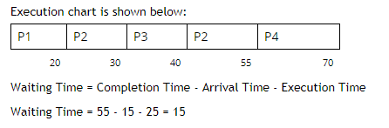
Solution
Avg. Turnaround time= 23.75
Avg. Waiting time= 6.25
‹#›

Slide 70
Example-03
Consider the following table of arrival time and burst time for three processes P0, P1 and P2. ----------------------------------- Process Arrival time Burst Time ----------------------------------- P0 0 ms 9 ms P1 1 ms 4 ms P2 2 ms 9 ms ----------------------------------- The pre-emptive shortest job first scheduling algorithm is used. Scheduling is carried out only at arrival or completion of processes. What is the average waiting time for the three processes?
(a) 5.0 ms (b) 4.33 ms (c) 6.33 ms (d) 7.33 ms
‹#›

Slide 71
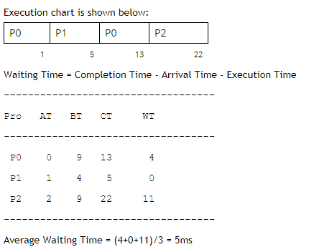
Solution
‹#›

Slide 72
Priority Scheduling
A priority number (integer) is associated with each process
The CPU is allocated to the process with the highest priority (smallest integer ≡ highest priority)
Preemptive
Non preemptive
Notes:
‹#›

Slide 73
Example-1 Non-Preemptive Priority Scheduling
ProcessA arri Burst TimeT Priority
P₁ 10 3
P₂ 1 1
P₃ 2 4
P₄ 1 5
P₅ 5 2
Priority scheduling Gantt Chart
Average waiting time = 8.2 msec
P₂
P₅
P₁
P₃
P₄
0
1
6
16
18
19
Notes:
‹#›

Slide 74
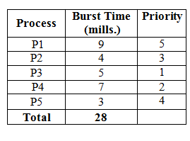
Example-2 Non-Preemptive Priority Scheduling
Find
T.W.T = Total Waiting Time
A.W.T = Average Waiting Time
T.T.T = Total Turnaround Time
A.T.T = Average Turnaround Time
‹#›

Slide 75
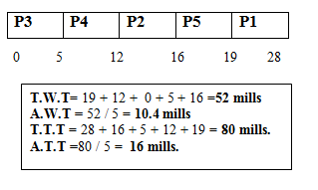
Solution
‹#›

Slide 76
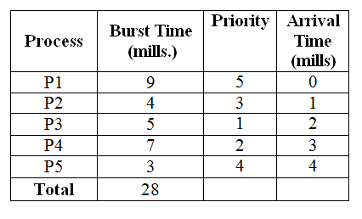
Example-3 Priority with Preemptive
Find
AVG. Waiting Time
AVG. Turnaround Time
‹#›

Slide 77
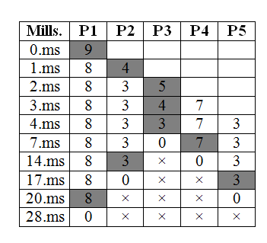
Solution
‹#›

Slide 78
Average Waiting Time
P1 = 20 - 1 - 0 = 19
P2 = 14 - 1 - 1 = 12
P3 = 4 - 2 - 2 = 0
P4 = 7 - 0 - 3 = 4
P5 = 17 - 0 - 4 = 13
------------------------
Total 48 Mills.
Average Waiting Time = Total Waiting Time / No.of Process
48 / 5 (No.of Process)
= 9.6 Mills.
‹#›

Slide 79
Average Turnaround Time
P1 = 28 - 0 = 28
P2 = 17 - 1 = 16
P3 = 7 - 2 = 5
P4 = 14 - 3 = 11
P5 = 20 - 4 = 16
------------------------
Total 76 Mills.
Average Turnaround Time = Total Turnaround Time / No.of Process
76 / 5
=15.2 Mills.
‹#›

Slide 80
Ex-03
process | CPU Burst Time | Priority | Arrival
p1 | 10 | 3 | 0
p2 | 5 | 2 | 1
p3 | 2 | 1 | 2
Find Average Waiting Time?
Let us assume that 1 is the highest priority whereas 3 is the least priority.
‹#›

Slide 81
Solution
p1 | p2 | p3 | p2 | p1
0
1
2
4
8
17
Waiting time for P1= 7
Waiting time for P2= 2
Waiting time for P3 = 0
Average Waiting Time = (7+2+0) / 3 = 3 Millisecond
‹#›

Slide 82
Limitation
indefinite blocking or starvation
In priority scheduling some low priority process may keep waiting indefinitely for CPU. In a heavily loaded system continuous arrival of higher priority processes can prevent low priority process from getting the CPU.
‹#›

Slide 83
Solution
One solution to the problem of starvation is aging
Aging is a technique of gradually increasing the priority of process that waits in the system for a longer period of time.
Eg:- If priority range from 127(low) – 0(high) we could decremented the priority of waiting process by every 15 minutes.
‹#›

Slide 84
Round Robin (RR)
Each process gets a small unit of CPU time (time quantum q), usually 10-100 milliseconds. After this time has elapsed, the process is preempted and added to the end of the ready queue.
If there are n processes in the ready queue and the time quantum is q, then each process gets 1/n of the CPU time in chunks of at most q time units at once. No process waits more than (n-1)q time units.
Timer interrupts every quantum to schedule next process
Performance
q large ⇒ FIFO
q small ⇒ q must be large with respect to context switch, otherwise overhead is too high
Notes:
‹#›

Slide 85
Example of RR with Time Quantum = 4
Process Burst Time
P₁ 24
P₂ 3
P₃ 3
Draw Gantt chart
Typically, higher average turnaround than SJF, but better response
q should be large compared to context switch time
q usually 10ms to 100ms, context switch < 10 usec
P₁
P₂
P₃
P₁
P₁
P₁
P₁
P₁
0
4
7
10
14
18
22
26
30
Notes:
‹#›

Slide 86
Ex-01
----------------------- Job-Id CPU-BurstTime ----------------------- p 4 q 1 r 8 s 1 t 2 ----------------------- The jobs are assumed to have arrived at time 0 and in the order p, q, r, s, t. Calculate the departure time (completion time) for job p if scheduling is round robin with time slice 1.
(a) 4 (b) 10 (c) 11 (d) 12
‹#›

Slide 87
Solution
P | Q | R | S | T | P | R | T | P | R | P | R
1 | 2 | 3 | 4 | 5 | 6 | 7 | 8 | 9 | 10 | 11 | 16
‹#›

Slide 88
Ex-02
Process |Arrival time |Service time (Burst time) P1 | 0 | 4
P2 | 3 | 6 P3 | 5 | 3 P4 | 8 | 2
Time quantum=2
Draw Gantt Chart
‹#›

Slide 89
Ex-03
P. No. A.T. B.T.
P1 0 4
P2 1 5
P3 2 2
P4 3 1
P5 4 6
P6 6 3
Calculate the Turnaround time and waiting time of the processes on the basis of round robin scheduling algorithm. Assume Time Quantum is set to 2 units. Also calculate the average waiting time and turn around time.
‹#›

Slide 90

Solution
Ready State : P1 P2 P3 P1 P4 P5 P2 P6 P5 P2 P6 P5
P No. | AT | BT | CT | TAT | WT
1 | 0 | 4 | 8 | 8 | 4
2 | 1 | 5 | 18 | 17 | 12
3 | 2 | 2 | 6 | 4 | 2
4 | 3 | 1 | 9 | 6 | 5
5 | 4 | 6 | 21 | 17 | 11
6 | 6 | 3 | 19 | 13 | 10
 |  |  |  | 67/6=10.8 | 46/6=7.3
‹#›

Slide 91
Ex-04
P No. | AT | BT
P1 | 5 | 5
P2 | 4 | 6
P3 | 3 | 7
P4 | 1 | 9
P5 | 2 | 2
P6 | 6 | 3
Calculate the Turnaround time and waiting time of the processes on the basis of round robin scheduling algorithm. Assume Time Quantum is set to 3 units. Also calculate the average waiting time and turn around time.
‹#›

Slide 92

Solution
Ready State : P4 P5 P3 P2 P4 P1 P6 P3 P2 P4 P1 P3
P No. | AT | BT | CT | TAT | WT
1 | 5 | 5 | 31 | 26 | 21
2 | 4 | 6 | 29 | 25 | 19
3 | 3 | 7 | 32 | 29 | 22
4 | 1 | 9 | 26 | 25 | 16
5 | 2 | 2 | 5 | 3 | 1
6 | 6 | 3 | 20 | 14 | 11
 |  |  |  | 128/6=21.3 | 92/6=15.3
‹#›

Slide 93
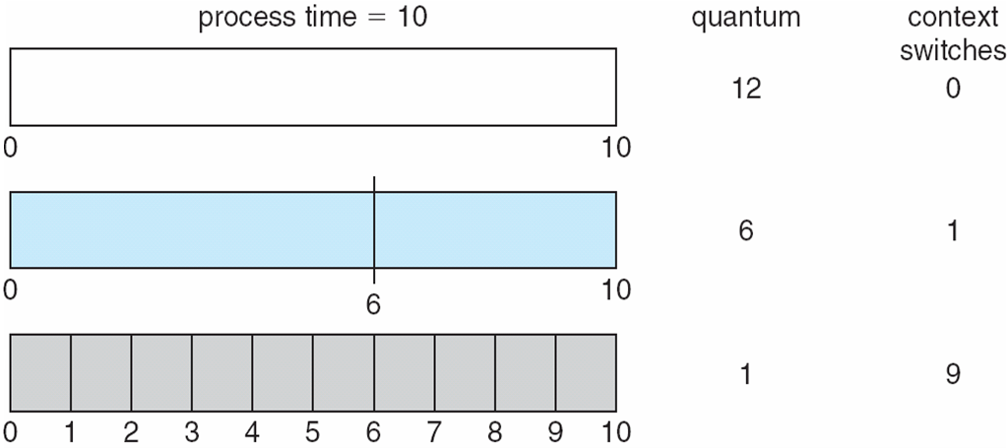
Time Quantum and Context Switch Time
Notes:
‹#›

Slide 94
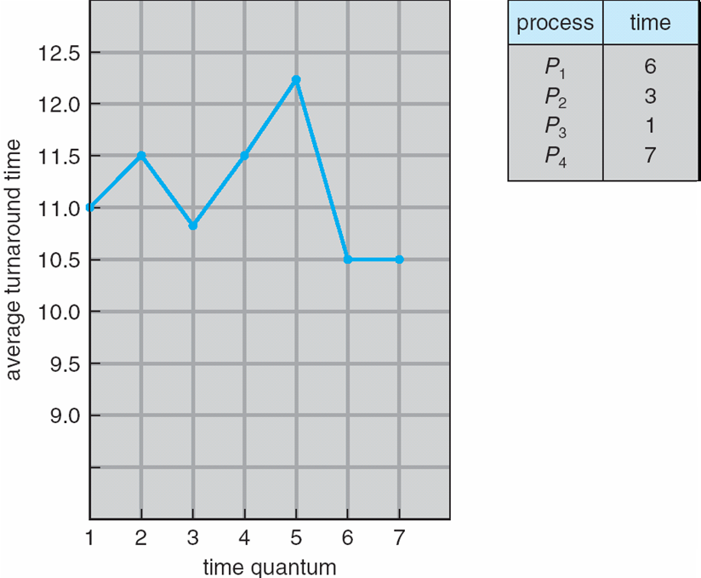
Turnaround Time Varies With The Time Quantum
80% of CPU bursts should be shorter than q
Notes:
‹#›

Slide 95
Multilevel Queue
Ready queue is partitioned into separate queues, eg:
foreground (interactive)
background (batch)
Process permanently in a given queue
Each queue has its own scheduling algorithm:
foreground – RR
background – FCFS
Scheduling must be done between the queues:
Fixed priority scheduling; (i.e., serve all from foreground then from background). Possibility of starvation.
Time slice – each queue gets a certain amount of CPU time which it can schedule amongst its processes; i.e., 80% to foreground in RR
20% to background in FCFS
Notes:
‹#›

Slide 96
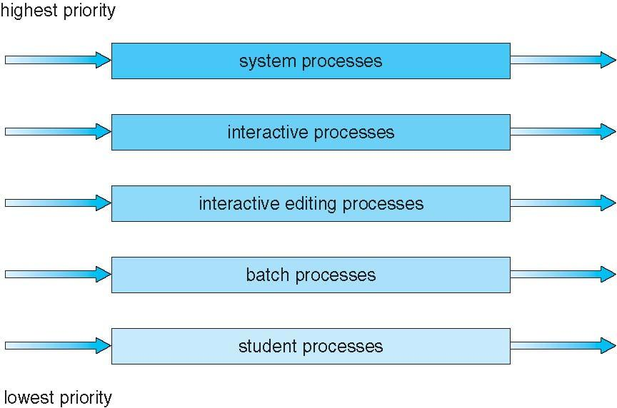
Multilevel Queue Scheduling
Notes:
‹#›

Slide 97
Example of Multilevel Feedback Queue
Three queues:
Q₀ – RR with time quantum 8 milliseconds
Q₁ – RR time quantum 16 milliseconds
Q₂ – FCFS
Scheduling
A new job enters queue Q₀ which is served FCFS
When it gains CPU, job receives 8 milliseconds
If it does not finish in 8 milliseconds, job is moved to queue Q₁
At Q₁ job is again served FCFS and receives 16 additional milliseconds
If it still does not complete, it is preempted and moved to queue Q₂
Notes:
‹#›

Slide 98
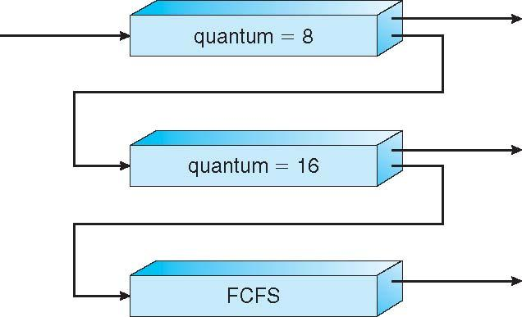
Multilevel Feedback Queues
Notes:
‹#›

Slide 99
Process Creation
Parent process create children processes, which, in turn create other processes, forming a tree of processes
Resource sharing
Parent and children share all resources
Children share subset of parent’s resources
Parent and child share no resources
Execution
Parent and children execute concurrently
Parent waits until children terminate

Slide 100
Process Creation (Cont.)
Address space
Child duplicate of parent
Child has a program loaded into it
UNIX examples
fork system call creates new process
exec system call used after a fork to replace the process’ memory space with a new program

Slide 101
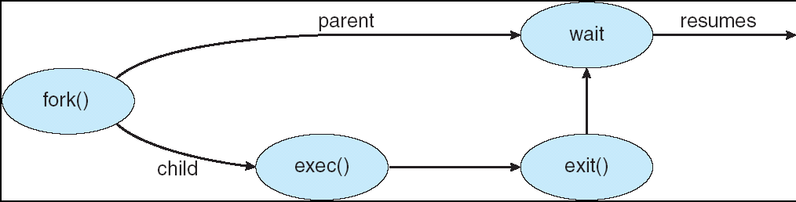
Process Creation

Slide 102
C Program Forking Separate Process
int main()
{
Pid_t pid;
/* fork another process */
pid = fork();
if (pid < 0) { /* error occurred */
fprintf(stderr, "Fork Failed");
exit(-1);
}
else if (pid == 0) { /* child process */
execlp("/bin/ls", "ls", NULL);
}
else { /* parent process */
/* parent will wait for the child to complete */
wait (NULL);
printf ("Child Complete");
exit(0);
}
}

Slide 103
Process Termination
Process executes last statement and asks the operating system to delete it (exit)
Output data from child to parent (via wait)
Process’ resources are deallocated by operating system
Parent may terminate execution of children processes (abort)
Child has exceeded allocated resources
Task assigned to child is no longer required
If parent is exiting
Some operating system do not allow child to continue if its parent terminates
All children terminated - cascading termination

Slide 104
Thank You

